Slide 1
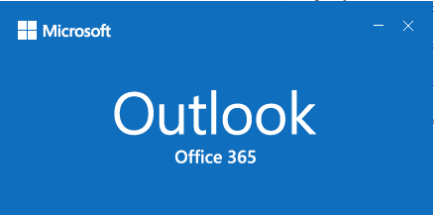

Download & Sort Mail Attachments Workflow Example

Slide 2
Start
Open Oulook if not already open
Get Top N messages from folders
Get Attachments from messages
Sort Attachments based on file extension e.g. .xlsx, .jpg, .docx
Save Attachments in folder to named same as extension of attachment file
Finish

